Slide 1
Global Warming UK GREENHOUSE GAS EMISSIONS 1990-2020
Project 1 – Group 4
Grace Cheuk (gw-sc)
Navindeep Bains (navinbains)
Salma Abdirahman (Salma-Abdirahman)
Farjana Rowther (fbrowther)

Slide 2
Agenda
01. Introduction
2. Who?
What we’re looking at and why we chose it
Which Sector produces the most emissions?
Which End User is responsible for most emissions?
03. What?
04. How?
05. Closing
Which fuel used contributes to the most emissions?
How much of our activities has changed over the course of time ?
Final conclusions and analysis.

Slide 3

INTRODUCTION
Greenhouse gases (GHGs) warm the Earth by absorbing energy and slowing the rate at which the energy dissipates to space; thus insulating the Earth

Slide 4
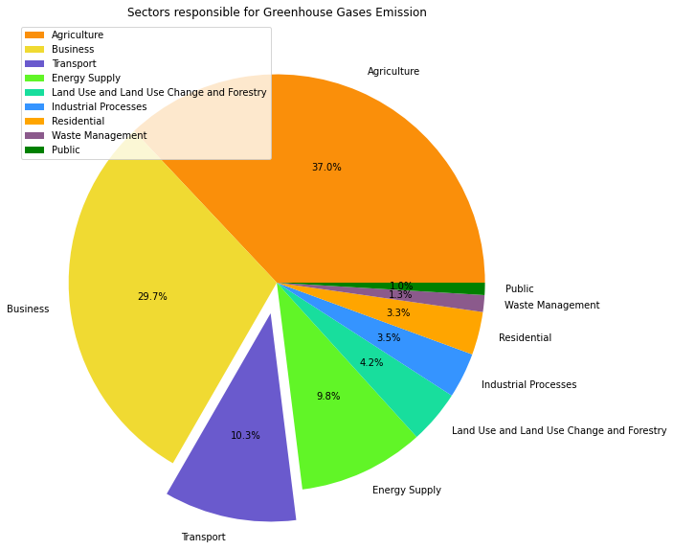
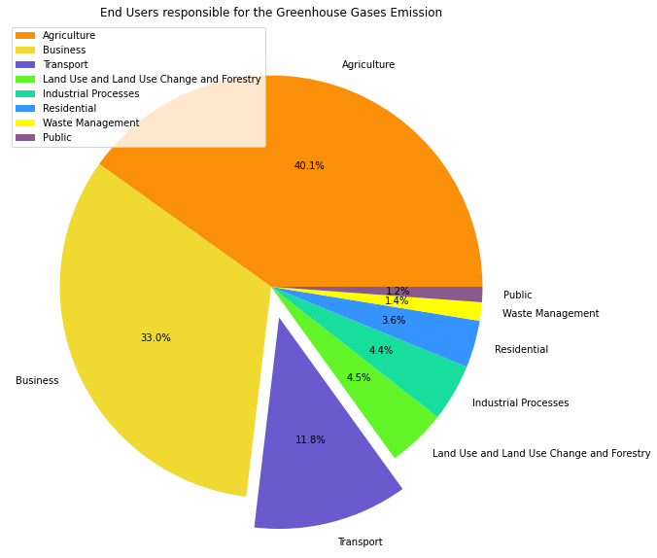
WHO?
WHICH SECTOR EMITS MOST
WHICH END USERS EMITS MOST

Slide 5
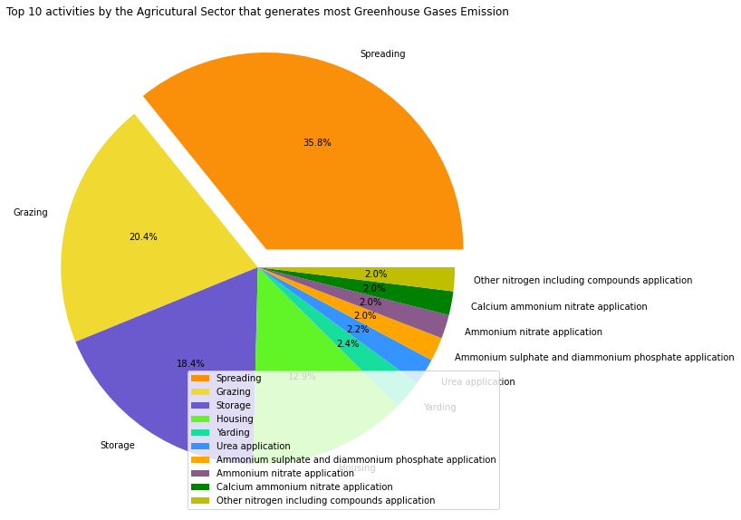
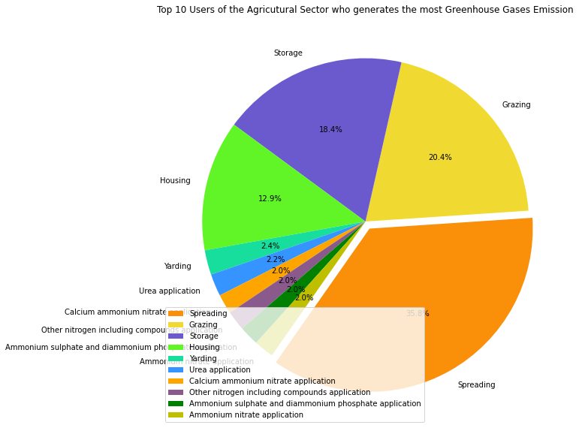
1st Contributor – Agriculture Sector
SOURCE
END-USERS

Slide 6
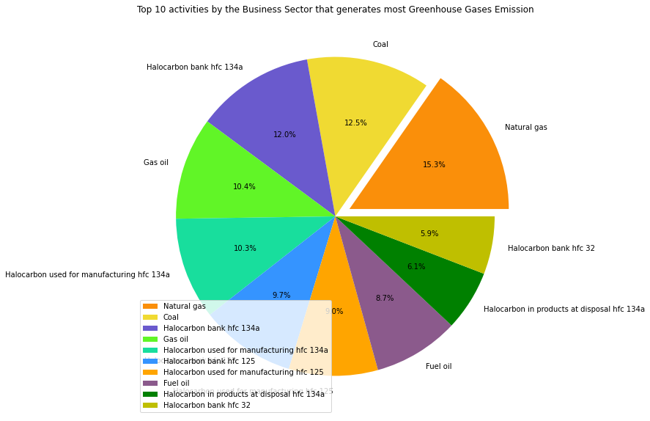

2nd Contributor - Business Sector
SOURCE
END-USERS

Slide 7
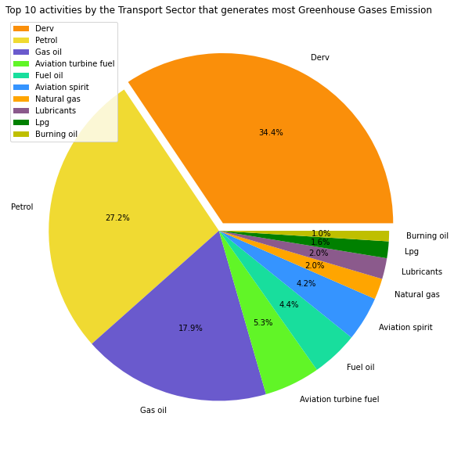
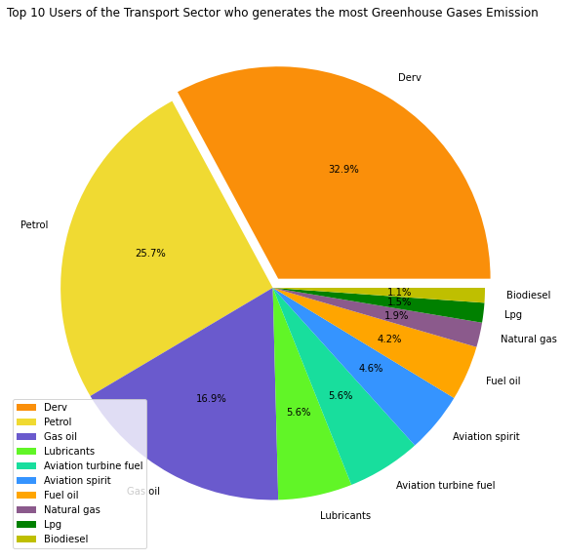
3rd Contributor - Transport Sector
SOURCE
END-USERS

Slide 8
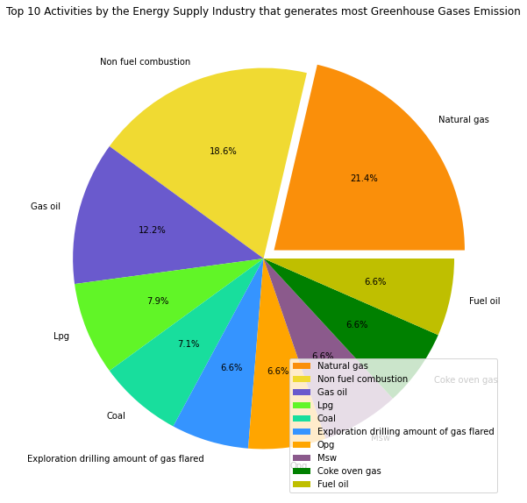
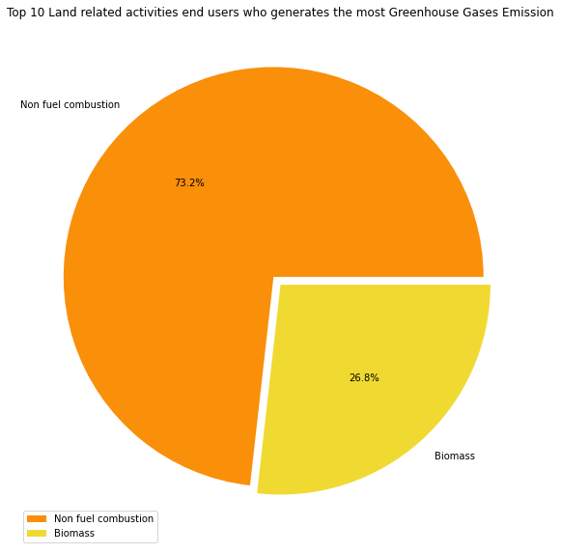
4th Contributor – Energy/Land-related Sector
SOURCE - ENERGY
END-USERS - LAND-Related
Drainage of organic soils releases CO₂ and NO₂ into the atmosphere
Farming (Cropland)
Wetland - Plants growing in wetlands emit methane to the atmosphere.
Biomass Burning

Slide 9
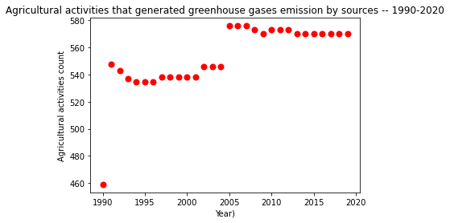
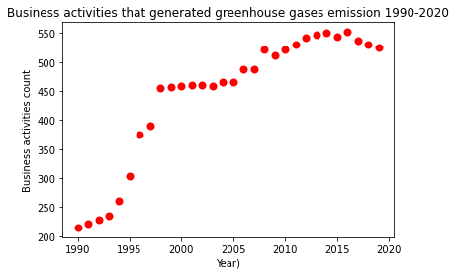
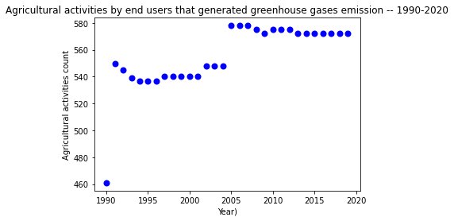
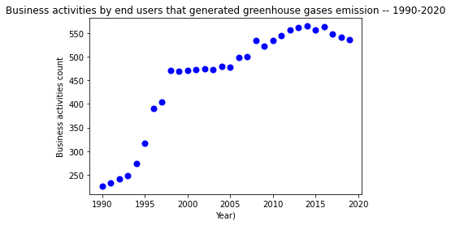
Contributor’s Trend- Agriculture & Business sector
SOURCE v/s END-USERS TREND 1990 -2020

Slide 10
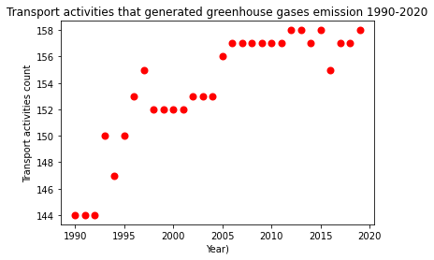
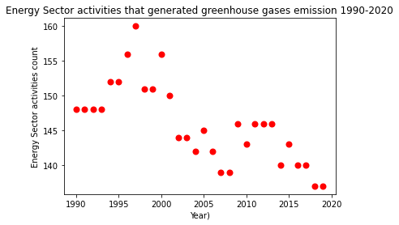
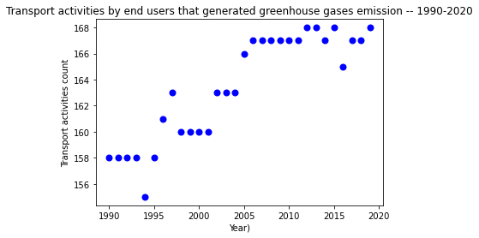
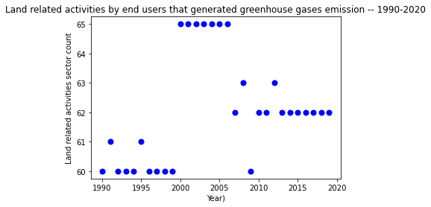
Contributor’s Trend- Transport & Energy/Land sector
SOURCE v/s END-USERS TREND 1990 -2020

Slide 11
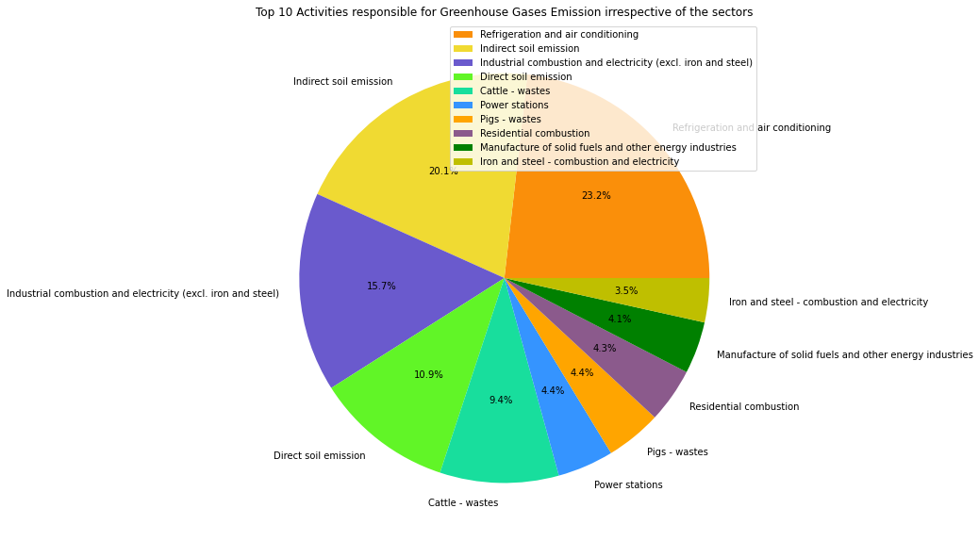
Top 10 contributors irrespective of sector
SOURCES & END-USERS

Slide 12
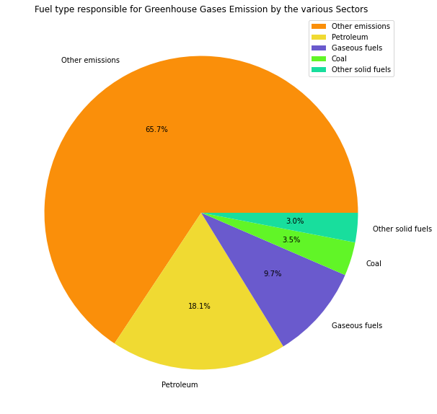
Fuel-Type
SOURCE & END-USERS
Other Emissions include –
Cattle, Horses, Pig and Poultry wastes
Soil emission (both direct and indirect),
Refrigeration and air conditioning,
Waste incineration,
Glass Production,
Gas flare,
Chemical Industries,
Power stations,
Drainage of organic soils - settlements
Industrial combustion,
Manufacture of solid fuels and other energy industries.

Slide 13
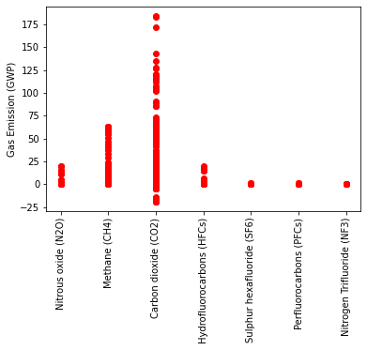
Composition of Greenhouse Gases
SOURCE & END-USERS
1. Carbon dioxide (CO₂)–
CO₂ causes 80% of global warming and its release is mainly contributed by fossil fuels burning like coal, oil and gas or deforestation.
2. Methane (CH₄)–
Methane possess >80 times the warming power of carbon dioxide for the first 20 years after being released
3. Nitrous oxide (NO₂) –
Increased N- based fertilizer use (>50 years) has been responsible for dramatic increase in its emission.
4. Hydrofluorocarbons (HFC) –
HFCs are highly effective at trapping solar radiation (infrared radiation) and redirecting that radiant energy toward Earth's surface.
Major source of HFCs are refrigeration and air conditioning

Slide 14
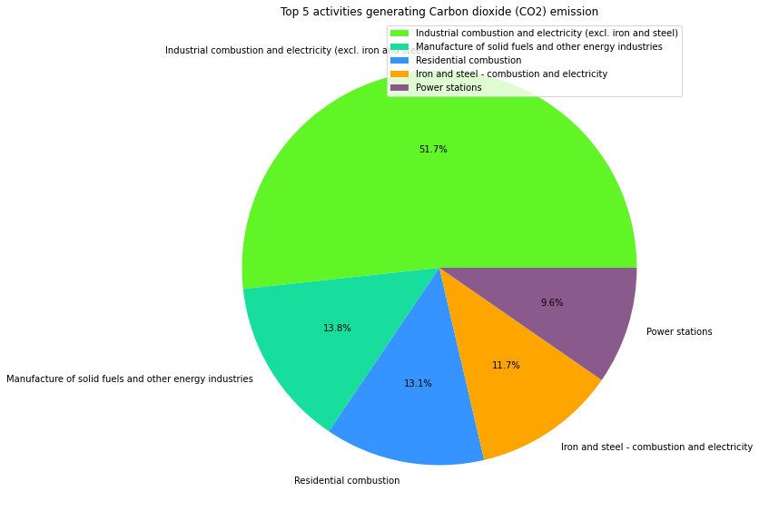
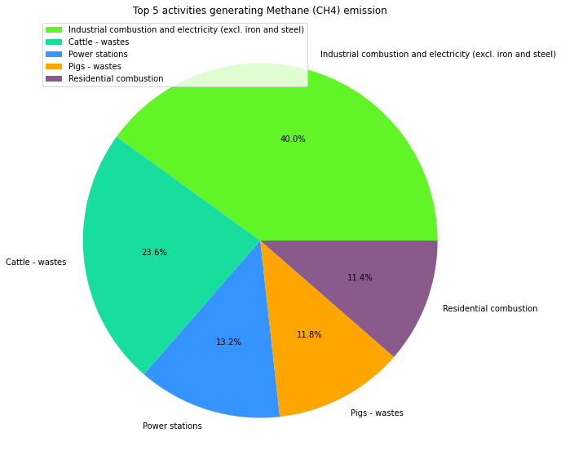
Top Emitters of -
CO₂
Methane

Slide 15
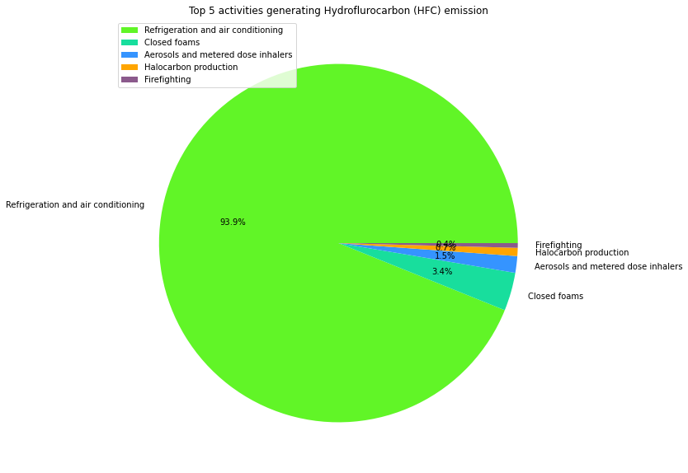
Top Emitters
NO₂
Hydrofluorocarbons

Slide 16

SUMMARY
WHO – MAJOR SECTORS RESPONSIBLE
TOP ACTIVITIES
Refrigeration and air conditioning,
Soil emission (direct and indirect),
Industrial combustion and electricity,
Cattle & Pig wastes,
Power stations,
Residential combustion,
Manufacture of solid fuels and other energy industries.
Agriculture,
Business,
Transport,
Energy
Land-related activities
TREND
CONCLUSION
There still exists an upward trend in the activities of the major contributing sectors
The policy makers need to take stringent urgent measures that ensures current practices are rapidly transformed to slow the release of the greenhouse gas emission
Alternatively we should also look into modalities to capture and transform already released gases to limit its damages.

Slide 17

Thank you
Group 4

